Slide 1
TRAINING DAY 5
ARRAYS & FUNCTIONS IN C++

Slide 2
Arrays Hold Multiple Values
Array: variable that can store multiple values of the same type
Values are stored in adjacent memory locations
Declared using [] operator:
int tests[5];

Slide 3
Array - Memory Layout
The definition:
int tests[5];
allocates the following memory:
first element | second element | third element | fourth element | fifth element

Slide 4
Array Terminology
In the definition int tests[5];
int is the data type of the array elements
tests is the name of the array
5, in [5], is the size declarator. It shows the number of elements in the array.
The size of an array is (number of elements) * (size of each element)

Slide 5
Array Terminology
The size of an array is:
the total number of bytes allocated for it
(number of elements) * (number of bytes for each element)
Examples:
int tests[5] is an array of 20 bytes, assuming 4 bytes for an int
long double measures[10]is an array of 80 bytes, assuming 8 bytes for a long double

Slide 6
Size Declarators
Named constants are commonly used as size declarators. const int SIZE = 5; int tests[SIZE];
This eases program maintenance when the size of the array needs to be changed.

Slide 7
Accessing Array Elements
Each element in an array is assigned a unique subscript.
Subscripts start at 0
subscripts:
0 | 1 | 2 | 3 | 4

Slide 8
Accessing Array Elements
The last element’s subscript is n-1 where n is the number of elements in the array.
subscripts:
0 | 1 | 2 | 3 | 4

Slide 9
Accessing Array Elements
Array elements can be used as regular variables:
tests[0] = 79;
cout << tests[0];
cin >> tests[1];
tests[4] = tests[0] + tests[1];
Arrays must be accessed via individual elements:
cout << tests; // not legal

Slide 10
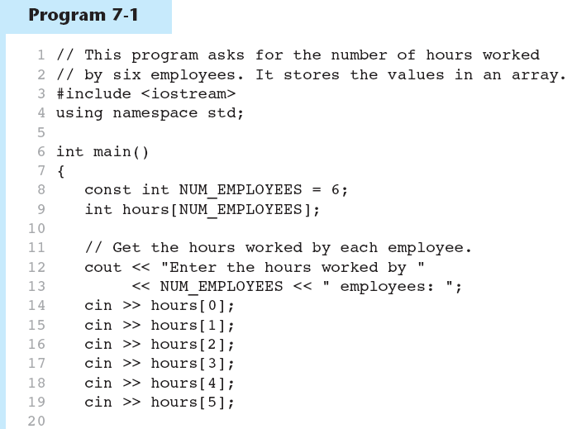

(Program Continues)

Slide 11
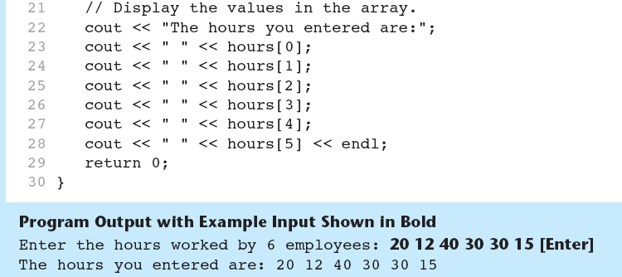
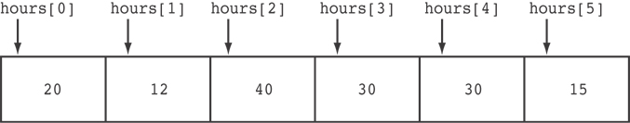
Here are the contents of the hours array, with the values entered by the user in the example output:

Slide 12
Accessing Array Contents
Can access element with a constant or literal subscript:
cout << tests[3] << endl;
Can use integer expression as subscript:
int i = 5;
cout << tests[i] << endl;

Slide 13
Using a Loop to Step Through an Array
Example – The following code defines an array, numbers, and assigns 99 to each element:
const int ARRAY_SIZE = 5;
int numbers[ARRAY_SIZE];
for (int count = 0; count < ARRAY_SIZE; count++)
numbers[count] = 99;

Slide 14
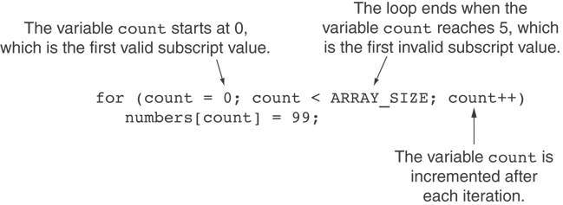
A Closer Look At the Loop

Slide 15
Default Initialization
Global array → all elements initialized to 0 by default
Local array → all elements uninitialized by default

Slide 16
Array Initialization
Arrays can be initialized with an initialization list: const int SIZE = 5; int tests[SIZE] = {79,82,91,77,84};
The values are stored in the array in the order in which they appear in the list.
The initialization list cannot exceed the array size.

Slide 17
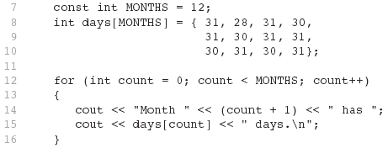
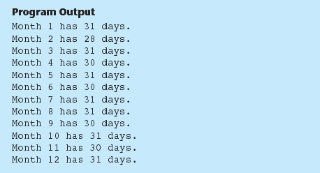
Code From Program 7-6

Slide 18
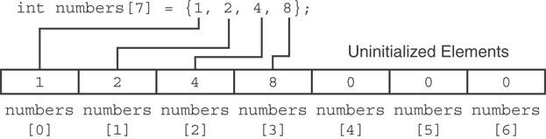
Partial Array Initialization
If array is initialized with fewer initial values than the size declarator, the remaining elements will be set to 0:

Slide 19
Implicit Array Sizing
Can determine array size by the size of the initialization list:
int quizzes[]={12,17,15,11};
Must use either array size declarator or initialization list at array definition
12 | 17 | 15 | 11

Slide 20
Initializing With a String
Character array can be initialized by enclosing string in " ":
const int SIZE = 6; char fName[SIZE] = "Henry";
Must leave room for \0 at end of array
If initializing character-by-character, must add in \0 explicitly:
char fName[SIZE] =
{ 'H', 'e', 'n', 'r', 'y', '\0'};

Slide 21
Processing Array Contents
Array elements can be treated as ordinary variables of the same type as the array
When using ++, -- operators, don’t confuse the element with the subscript:
tests[i]++; // add 1 to tests[i]
tests[i++]; // increment i, no
// effect on tests

Slide 22
Array Assignment
To copy one array to another,
Don’t try to assign one array to the other:
newTests = tests; // Won't work
Instead, assign element-by-element:
for (i = 0; i < ARRAY_SIZE; i++)
newTests[i] = tests[i];

Slide 23
Printing the Contents of an Array
You can display the contents of a character array by sending its name to cout: char fName[] = "Henry";
cout << fName << endl;
But, this ONLY works with character arrays!

Slide 24
Printing the Contents of an Array
For other types of arrays, you must print element-by-element:
for (i = 0; i < ARRAY_SIZE; i++)
cout << tests[i] << endl;

Slide 25
Summing and Averaging Array Elements
Use a simple loop to add together array elements:
int tnum;
double average, sum = 0;
for(tnum = 0; tnum < SIZE; tnum++)
sum += tests[tnum];
Once summed, can compute average:
average = sum / SIZE;

Slide 26
Finding the Highest Value in an Array
int count;
int highest;
highest = numbers[0];
for (count = 1; count < SIZE; count++)
{
if (numbers[count] > highest)
highest = numbers[count];
}
When this code is finished, the highest variable will contains the highest value in the numbers array.

Slide 27
Finding the Lowest Value in an Array
int count;
int lowest;
lowest = numbers[0];
for (count = 1; count < SIZE; count++)
{
if (numbers[count] < lowest)
lowest = numbers[count];
}
When this code is finished, the lowest variable will contains the lowest value in the numbers array.

Slide 28
Partially-Filled Arrays
If it is unknown how much data an array will be holding:
Make the array large enough to hold the largest expected number of elements.
Use a counter variable to keep track of the number of items stored in the array.

Slide 29
Comparing Arrays
To compare two arrays, you must compare element-by-element:
const int SIZE = 5;
int firstArray[SIZE] = { 5, 10, 15, 20, 25 };
int secondArray[SIZE] = { 5, 10, 15, 20, 25 };
bool arraysEqual = true; // Flag variable
int count = 0; // Loop counter variable
// Compare the two arrays.
while (arraysEqual && count < SIZE)
{
if (firstArray[count] != secondArray[count])
arraysEqual = false;
count++;
}
if (arraysEqual)
cout << "The arrays are equal.\n";
else
cout << "The arrays are not equal.\n";

Slide 30
Two-Dimensional Arrays
Can define one array for multiple sets of data
Like a table in a spreadsheet
Use two size declarators in definition:
const int ROWS = 4, COLS = 3; int exams[ROWS][COLS];
First declarator is number of rows; second is number of columns

Slide 31
Two-Dimensional Array Representation
const int ROWS = 4, COLS = 3; int exams[ROWS][COLS];
Use two subscripts to access element:
exams[2][2] = 86;
columns
exams[0][0] | exams[0][1] | exams[0][2]
exams[1][0] | exams[1][1] | exams[1][2]
exams[2][0] | exams[2][1] | exams[2][2]
exams[3][0] | exams[3][1] | exams[3][2]
r
o
w
s

Slide 32
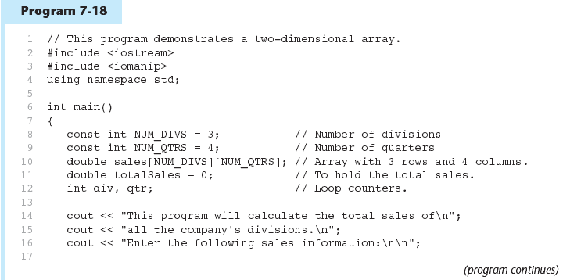

Slide 33
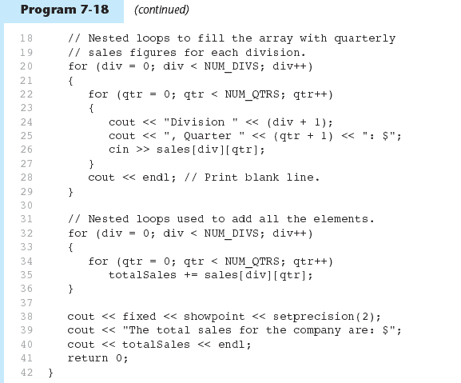

Slide 34
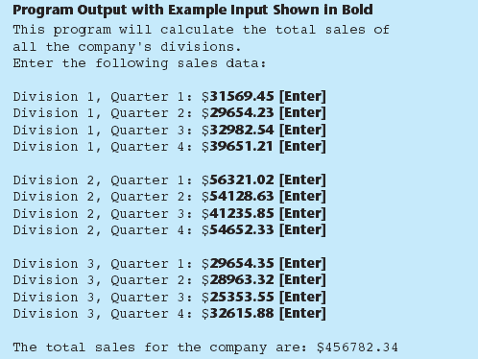

Slide 35
2D Array Initialization
Two-dimensional arrays are initialized row-by-row: const int ROWS = 2, COLS = 2; int exams[ROWS][COLS] = { {84, 78},
{92, 97} };
Can omit inner { }, some initial values in a row – array elements without initial values will be set to 0 or NULL
84 | 78
92 | 97

Slide 36
Two-Dimensional Array as Parameter, Argument
Use array name as argument in function call:
getExams(exams, 2);
Use empty [] for row, size declarator for column in prototype, header: const int COLS = 2; // Prototype void getExams(int [][COLS], int); // Header void getExams(int exams[][COLS], int rows)

Slide 37
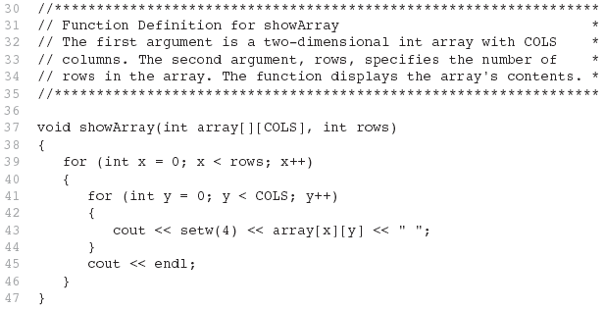
Example – The showArray Function from Program 7-19

Slide 38
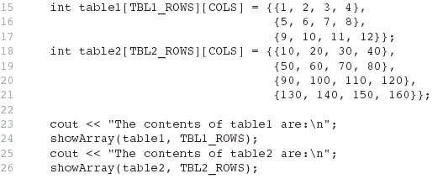
How showArray is Called

Slide 39
Summing All the Elements in a Two-Dimensional Array
Given the following definitions:
const int NUM_ROWS = 5; // Number of rows
const int NUM_COLS = 5; // Number of columns
int total = 0; // Accumulator
int numbers[NUM_ROWS][NUM_COLS] =
{{2, 7, 9, 6, 4},
{6, 1, 8, 9, 4},
{4, 3, 7, 2, 9},
{9, 9, 0, 3, 1},
{6, 2, 7, 4, 1}};

Slide 40
Summing All the Elements in a Two-Dimensional Array
// Sum the array elements.
for (int row = 0; row < NUM_ROWS; row++)
{
for (int col = 0; col < NUM_COLS; col++)
total += numbers[row][col];
}
// Display the sum.
cout << "The total is " << total << endl;

Slide 41
Summing the Rows of a Two-Dimensional Array
Given the following definitions:
const int NUM_STUDENTS = 3;
const int NUM_SCORES = 5;
double total; // Accumulator
double average; // To hold average scores
double scores[NUM_STUDENTS][NUM_SCORES] =
{{88, 97, 79, 86, 94},
{86, 91, 78, 79, 84},
{82, 73, 77, 82, 89}};

Slide 42
Summing the Rows of a Two-Dimensional Array
// Get each student's average score.
for (int row = 0; row < NUM_STUDENTS; row++)
{
// Set the accumulator.
total = 0;
// Sum a row.
for (int col = 0; col < NUM_SCORES; col++)
total += scores[row][col];
// Get the average
average = total / NUM_SCORES;
// Display the average.
cout << "Score average for student "
<< (row + 1) << " is " << average <<endl;
}

Slide 43
Summing the Columns of a Two-Dimensional Array
Given the following definitions:
const int NUM_STUDENTS = 3;
const int NUM_SCORES = 5;
double total; // Accumulator
double average; // To hold average scores
double scores[NUM_STUDENTS][NUM_SCORES] =
{{88, 97, 79, 86, 94},
{86, 91, 78, 79, 84},
{82, 73, 77, 82, 89}};

Slide 44
Summing the Columns of a Two-Dimensional Array
// Get the class average for each score.
for (int col = 0; col < NUM_SCORES; col++)
{
// Reset the accumulator.
total = 0;
// Sum a column
for (int row = 0; row < NUM_STUDENTS; row++)
total += scores[row][col];
// Get the average
average = total / NUM_STUDENTS;
// Display the class average.
cout << "Class average for test " << (col + 1)
<< " is " << average << endl;
}

Slide 45
Array of Strings
Use a two-dimensional array of characters as an array of strings: const int NAMES = 3, SIZE = 10; char students[NAMES][SIZE] =
{ "Ann", "Bill", "Cindy" };
Each row contains one string
Can use row subscript to reference the string in a particular row:
cout << students[i];

Slide 46
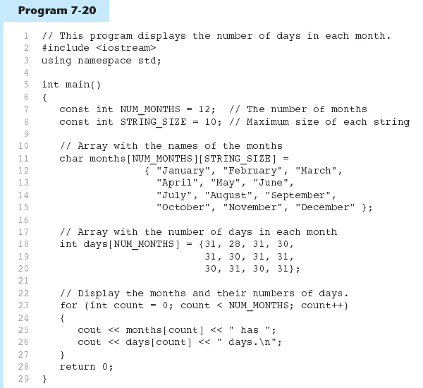

Slide 47
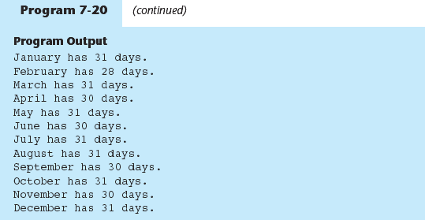

Slide 48
Arrays with Three or More Dimensions
Can define arrays with any number of dimensions:
short rectSolid[2][3][5];
double timeGrid[3][4][3][4];
When used as parameter, specify all but 1st dimension in prototype, heading:
void getRectSolid(short [][3][5]);

Slide 49
VERY IMPORTANT INSIGHT
ARRAY NAME IS A POINTER THAT POINTS TO FIRST ELEMENT OF AN ARRAY
PRINT ARRAY NAME= YOU WILL GET AN ADDRESS

Slide 50
Introduction to Functions

Slide 51
Introduction to Functions
A complex problem is often easier to solve by dividing it into several smaller parts, each of which can be solved by itself.
This is called structured programming.
These parts are sometimes made into functions in C++.
main() then uses these functions to solve the original problem.

Slide 52
Advantages of Functions
Functions separate the concept (what is done) from the implementation (how it is done).
Functions make programs easier to understand.
Functions can be called several times in the same program, allowing the code to be reused.

Slide 53
C++ Functions
C++ allows the use of both internal (user-defined) and external functions.
External functions (e.g., abs, ceil, rand, sqrt, etc.) are usually grouped into specialized libraries (e.g., iostream, stdlib, math, etc.)

Slide 54
Predefined Functions
Libraries full of functions for our use!
Two types:
Those that return a value
Those that do not (void)
Must "#include" appropriate library
e.g.,
<cmath>, <cstdlib> (Original "C" libraries)
<iostream> (for cout, cin)

Slide 55
Using Predefined Functions
Math functions very plentiful
Found in library <cmath.h>
Most return a value (the "answer")
Example: theRoot = sqrt(9.0);
Components: sqrt = name of library function theRoot = variable used to assign "answer" to 9.0 = argument or "starting input" for function
In I-P-O:
I = 9.0
P = "compute the square root"
O = 3, which is returned & assigned to theRoot

Slide 56
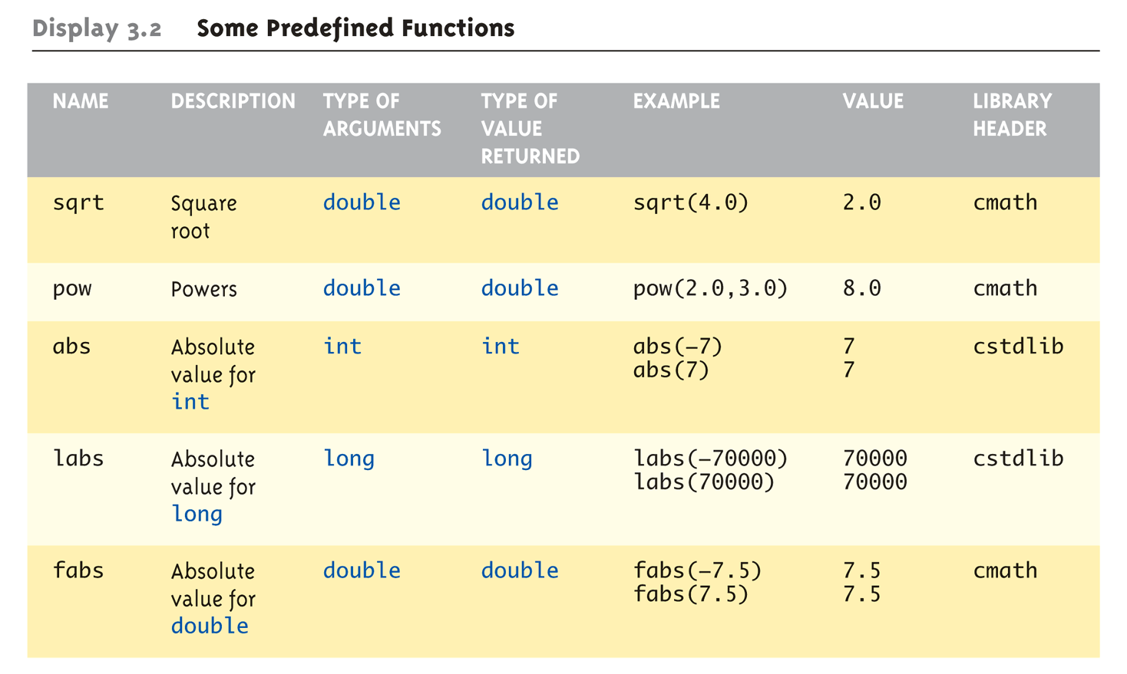
Even More Math Functions: Some Predefined Functions (1 of 2)

Slide 57
Predefined Void Functions
No returned value
Performs an action, but sends no "answer"
When called, it’s a statement itself
exit(1); // No return value, so not assigned
This call terminates program
void functions can still have arguments
All aspects same as functions that "return a value"
They just don’t return a value!

Slide 58
User-Defined Functions
C++ programs usually have the following form:
// include statements
// function prototypes
// main() function
// function definitions

Slide 59

Function Input and Output

Slide 60
C++ Functions
C++ functions have a list of parameters.
Parameters are the things we give the function to operate on.
Each parameter has a type.
There can be zero parameters.

Slide 61
Function Definition
A function definition has the following syntax:
<type> <function name>(<parameter list>)
{
<local declarations>
<sequence of statements>
}

Slide 62
Sample function
Return type
parameters
Function name
int add2ints(int a, int b)
{
return(a+b);
}
Function body

Slide 63
Function Definition
For example: Definition of a function that computes the absolute value of an integer:
int absolute(int x)
{
if (x >= 0) return x;
else return -x;
}

Slide 64
Using functions – Math Library functions
C++ includes a library of Math functions you can use.
You have to know how to call these functions before you can use them.
You have to know what they return.
You don’t have to know how they work!

Slide 65
double sqrt( double )
When calling sqrt, we have to give it a double.
The sqrt function returns a double.
We have to give it a double.
x = sqrt(y);
x = sqrt(100);

Slide 66
Telling the compiler about sqrt()
How does the compiler know about sqrt ?
You have to tell it:
#include <math.h>
Notes:
Try out the sqrt_table program at http://www.cs.rpi.edu/~hollingd/cpp/code. Try it without the include and with the include.

Slide 67
Function Call
A function call has the following syntax:
<function name>(<argument list>)
Example: int distance = absolute(-5);
The result of a function call is a value of type <type>

Slide 68
Writing a function
You have decide on what the function will look like:
Return type
Name
Types of parameters (number of parameters)
You have to write the body (the actual code).

Slide 69
Function parameters
The parameters are local variables inside the body of the function.
When the function is called they will have the values passed in.
The function gets a copy of the values passed in (we will later see how to pass a reference to a variable).

Slide 70
Arguments/Parameters
one-to-one correspondence between the arguments in a function call and the parameters in the function definition.
int argument1;
double argument2;
// function call (in another function, such as main)
result = thefunctionname(argument1, argument2);
// function definition
int thefunctionname(int parameter1, double parameter2){
// Now the function can use the two parameters
// parameter1 = argument 1, parameter2 = argument2

Slide 71
Sample Function
int add2nums( int firstnum, int secondnum ) {
int sum;
sum = firstnum + secondnum;
// just to make a point
firstnum = 0;
secondnum = 0;
return(sum);
}
Notes:
Available via the course home page in code/functions/add2nums.cpp

Slide 72
Testing add2nums
int main(void) {
int y,a,b;
cout << "Enter 2 numbers\n";
cin >> a >> b;
y = add2nums(a,b);
cout << "a is " << a << endl;
cout << "b is " << b << endl;
cout << "y is " << y << endl;
return(0);
}

Slide 73
What happens here?
int add2nums(int a, int b) {
a=a+b;
return(a);
}
…
int a,b,y;
…
y = add2nums(a,b);

Slide 74
Scope
The scope of a variable is the portion of a program where the variable has meaning (where it exists).
A global variable has global (unlimited) scope.
A local variable’s scope is restricted to the function that declares the variable.
A block variable’s scope is restricted to the block in which the variable is declared.

Slide 75
Understanding Scope
Some variables can be accessed throughout an entire program, while others can be accessed only in a limited part of the program
The scope of a variable defines where it can be accessed in a program
To adequately understand scope, you must be able to distinguish between local and global variables

Slide 76
Local variables
Parameters and variables declared inside the definition of a function are local.
They only exist inside the function body.
Once the function returns, the variables no longer exist!
That’s fine! We don’t need them anymore!

Slide 77
Block Variables
You can also declare variables that exist only within the body of a compound statement (a block):
{
int foo;
…
…
}

Slide 78
Global variables
You can declare variables outside of any function definition – these variables are global variables.
Any function can access/change global variables.
Example: flag that indicates whether debugging information should be printed.

Slide 79
Distinguishing Between Local and Global Variables
Celebrity names are global because they are known to people everywhere and always refer to those same celebrities
Global variables are those that are known to all functions in a program
Some named objects in your life are local
You might have a local co-worker whose name takes precedence over, or overrides, a global one

Slide 80
Distinguishing Between Local and Global Variables
Variables that are declared in a block are local to that block and have the following characteristics:
Local variables are created when they are declared within a block
Local variables are known only to that block
Local variables cease to exist when their block ends

Slide 81
Distinguishing Between Local and Global Variables
Variables declared within a function remain local to that function
In contrast, variables declared within curly braces within any function are local to that block

Slide 82
A note about Global vs. File scope
A variable declared outside of a function is available everywhere, but only the functions that follow it in the file know about it.
The book talks about file scope, I’m calling it global scope.

Slide 83
Block Scope
int main(void) {
int y;
{
int a = y;
cout << a << endl;
}
cout << a << endl;
}
Error – a doesn’t exist outside the block!

Slide 84
Absolute Value
#include <iostream.h>
int absolute (int);// function prototype for absolute()
int main()
{ int num, answer;
cout << "Enter an integer (0 to stop): ";
cin >> num;
while (num!=0){
answer = absolute(num);
cout << "The absolute value of " << num
<< " is: " << answer << endl;
cin >> num; }
return 0; }
// Define a function to take absolute value of an integer
int absolute(int x)
{
if (x >= 0) return x;
else return -x;
}

Slide 85
Function Prototype
The function prototype declares the input and output parameters of the function.
The function prototype has the following syntax:
<type> <function name>(<type list>);
Example: A function that returns the absolute value of an integer is: int absolute(int);

Slide 86
Function Definition
The function definition can be placed anywhere in the program after the function prototypes.
If a function definition is placed in front of main(), there is no need to include its function prototype.

Slide 87
POINTER VS REFERENCE VARIABLE
Pointer stores the address of another Variable
Reference Variable is an alias of another variable.
int *p=&a;
int &ref=a;

Slide 88
CALL BY VALUE,ADDRESS AND REFENCE
Call by Value- Passing values to function
Call by Reference- Passing Reference Variable to Function
Call by Address- Passing pointers to functions

Slide 89
Absolute Value (alternative)
Note that it is possible to omit the function prototype if the function is placed before it is called.
#include <iostream.h>
int absolute(int x)
{
if (x >= 0) return x;
else return -x;
}
int main()
{
int num, answer;
cout << "Enter an integer (0 to stop): ";
cin >> num;
while (num!=0){
answer = absolute(num);
cout << "The absolute value of " << num
<< " is: " << answer << endl;
cin >> num; }
return 0;
}

Slide 90
Passing Values to Functions
Many real-world functions you perform require that you provide information
A particular task might always be carried out in the same way, but with specific data
Consider a program that computes the amount of sales tax due on an item
You can write the prototype for computeTax() in one of two ways:
void computeTax(int);
OR
void computeTax(int price);

Slide 91
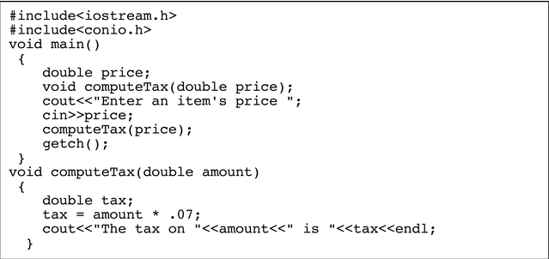
Passing Values to Functions

Slide 92
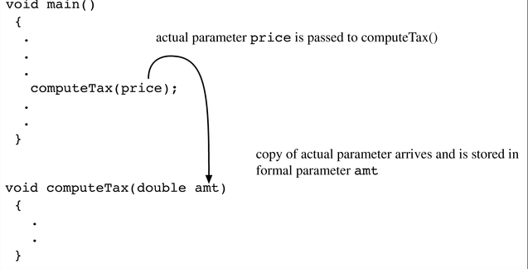
Passing Values to Functions

Slide 93
Function of three parameters
#include <iostream.h>
double total_second(int, double ,double );
int main()
{
cout << total_second(1,1.5, 2) << endl;
return 0;
}
double total_second( int hour, double minutes,
double second)
{
return hour*3600 + minutes * 60 + second;
}

Slide 94
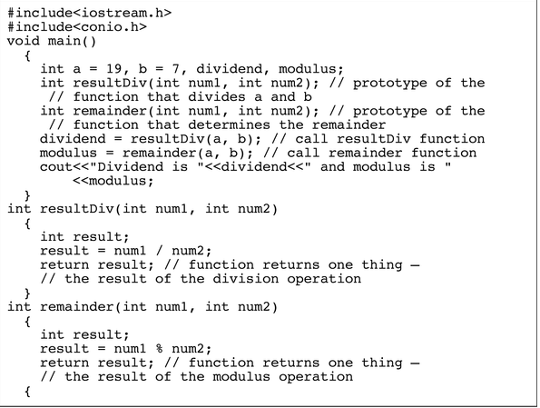
A Program That Calls Two Functions to Get Two Results
}

Slide 95
Passing Addresses to Functions
Just as variable values may be passed to and returned from functions, so may variable addresses
Passing an address to a function avoids having the function copy the passed object, a process that takes time and memory
You also can pass addresses to a function if you want a function to change multiple values
If you pass addresses to function, however, the function can change the contents at those actual memory addresses, eliminating the need to return any values at all

Slide 96
Passing Addresses to Functions
As an alternative to the program shown earlier, you can pass two memory addresses to one function, making a single function call, as shown in next program
In the program shown, four items are passed to the results() function: the value of a, the value of b, the address of dividend, and the address of modulus
In turn the results() function receives four items:
num1, which holds the value of a
num2, which holds the value of b
oneAddress, a pointer that holds the address of dividend
anotherAddress, a pointer that holds the address of modulus

Slide 97
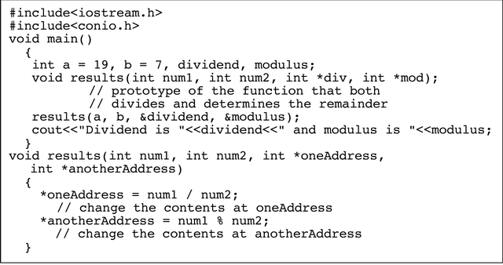
A Program That Calls One Function to Get Two Results

Slide 98
Passing Addresses to Functions
Passing an address of a variable to a function has a number of advantages:
If the function is intended to alter the variable, it alters the actual variable, not a copy of it
You can write the function to alter multiple values
When you send the address of a variable to a function, the function does not need to make a copy of the variable

Slide 99
Using Reference Variables with Functions
To create a second name for a variable in a program, you can generate an alias, or an alternate name
In C++ a variable that acts as an alias for another variable is called a reference variable, or simply a reference

Slide 100
Declaring Reference Variables
You declare a reference variable by placing a type and an ampersand in front of a variable name, as in double &cash; and assigning another variable of the same type to the reference variable
double someMoney;
double &cash = someMoney;
A reference variable refers to the same memory address as does a variable, and a pointer holds the memory address of a variable

Slide 101
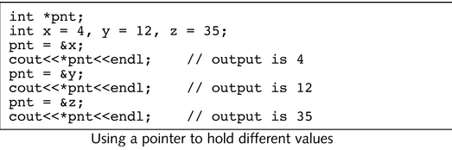
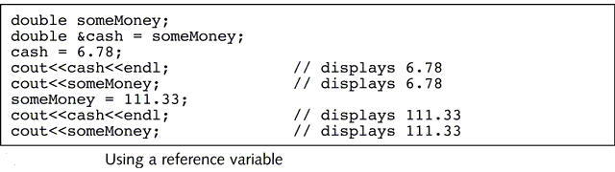
Declaring Reference Variables

Slide 102
Declaring Reference Variables
There are two differences between reference variables and pointers:
Pointers are more flexible
Reference variables are easier to use
You assign a value to a pointer by inserting an ampersand in front of the name of the variable whose address you want to store in the pointer
Figure 4-30 shows that when you want to use the value stored in the pointer, you must use the asterisk to dereference the pointer, or use the value to which it points, instead of the address it holds

Slide 103
Passing Variable Addresses to Reference Variables
Reference variables are easier to use because you don’t need any extra punctuation to output their values
You declare a reference variable by placing an ampersand in front of the variable’s name
You assign a value to a reference variable by using another variable’s name
The advantage to using reference variables lies in creating them in function headers

Slide 104
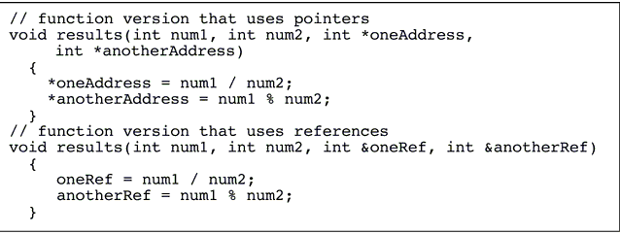
Comparing Pointers and References in a Function Header

Slide 105
Passing Variable Addresses to Reference Variables
When you pass a variable’s address to a function, whether with a pointer or with a reference, any changes to the variable made by the function also alter the actual variable
In addition, the function no longer needs to make a copy of the variable
A function that receives an address may change the variable—but sometimes you might not want the variable changed

Slide 106
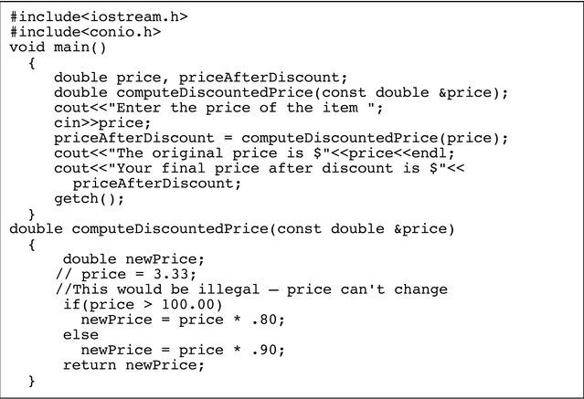
Using a Constant Reference

Slide 107
Passing Arrays to Functions
An array name actually represents a memory address
Thus, an array name is a pointer
The subscript used to access an element of an array indicates how much to add to the starting address to locate a value
When you pass an array to a function, you are actually passing an address
Any changes made to the array within the function also affect the original array

Slide 108
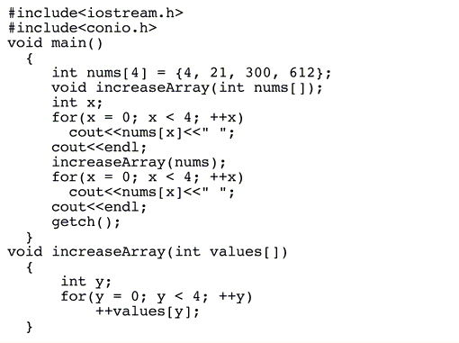
Passing an Array to a Function

Slide 109
Inline Functions
Each time you call a function in a C++ program, the computer must do the following:
Remember where to return when the function eventually ends
Provide memory for the function’s variables
Provide memory for any value returned by the function
Pass control to the function
Pass control back to the calling program
This extra activity constitutes the overhead, or cost of doing business, involved in calling a function

Slide 110
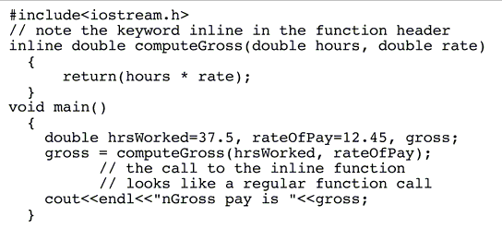
Using an Inline Function

Slide 111
Inline Functions
An inline function is a small function with no calling overhead
Overhead is avoided because program control never transfers to the function
A copy of the function statements is placed directly into the compiled calling program
The inline function appears prior to the main(), which calls it
Any inline function must precede any function that calls it, which eliminates the need for prototyping in the calling function

Slide 112
Inline Functions
When you compile a program, the code for the inline function is placed directly within the main() function
You should use an inline function only in the following situations:
When you want to group statements together so that you can use a function name
When the number of statements is small (one or two lines in the body of the function)
When the function is called on few occasions

Slide 113
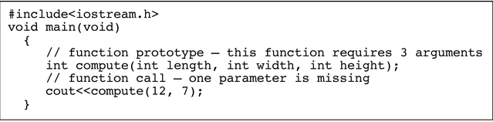
Using Default Arguments
When you don’t provide enough arguments in a function call, you usually want the compiler to issue a warning message for this error
Sometimes it is useful to create a function that supplies a default value for any missing parameters

Slide 114
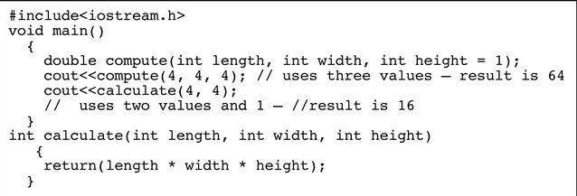
Using Default Arguments
Two rules apply to default parameters:
If you assign a default value to any variable in a function prototype’s parameter list, then all parameters to the right of that variable also must have default values
If you omit any argument when you call a function that has default parameters, then you also must leave out all arguments to the right of that argument

Slide 115
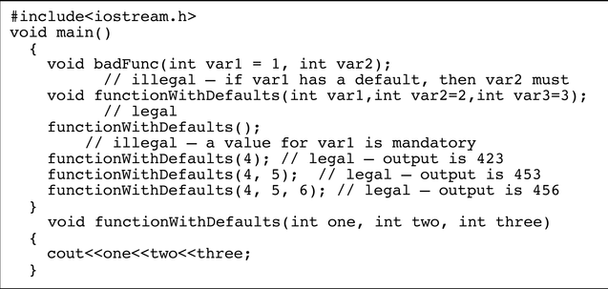
Examples of Legal and Illegal Use of Functions with Default Parameters

Slide 116
Arrays as Function Arguments
To pass an array to a function, just use the array name:
showScores(tests);
To define a function that takes an array parameter, use empty [] for array argument:
void showScores(int []);
// function prototype
void showScores(int tests[])
// function header

Slide 117
Arrays as Function Arguments
When passing an array to a function, it is common to pass array size so that function knows how many elements to process:
showScores(tests, ARRAY_SIZE);
Array size must also be reflected in prototype, header:
void showScores(int [], int);
// function prototype
void showScores(int tests[], int size)
// function header

Slide 118
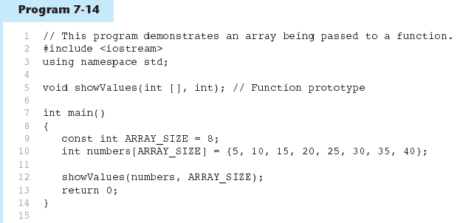
(Program Continues)

Slide 119
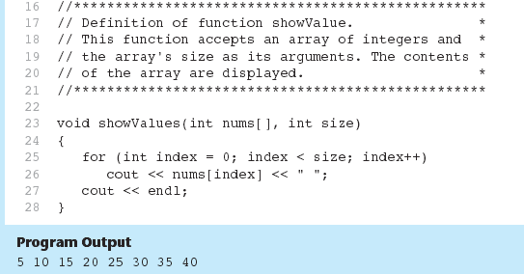
Program 7-14 (Continued)

Slide 120
Modifying Arrays in Functions
Array names in functions are like reference variables – changes made to array in a function are reflected in actual array in calling function
Need to exercise caution that array is not inadvertently changed by a function

